Slide 1

CVR COLLEGE OF ENGINEERING DEPARTMENT OF COMPUTER SCIENCE AND ENGINEERING
A Project seminar-I
on
Malicious URL detection
by
Under guidance of
Sr Asst Prof R Sahith
18B81A05G9 - Bhonagiri Shwetha
18B81A05D7- Kailash Ksheersagar
18B81A05H0 -Vanguru Sreeja

Slide 2
Contents
Abstract
Motivation
Literature review and Limitations of the existing models
Proposed work
Architecture of the project
Class Diagram
Data Flow Model
Data set description
Functions
Algorithms
Implementation
Results analysis
Conclusion
Future scope
References

Slide 3
Abstract
The primary use of a URL (Uniform Resource Locator) was to use it as a web address. However, some URLs can also be used to host unwanted content that could lead to cyber attacks. These URLs are called malicious URLs.
The inability of the end user system to detect and remove malicious URLs puts the legitimate user at risk. Additionally, the use of malicious URLs can lead to unauthorized access to user data by enemies. . It is important to combat the attack activities through some innovative method such as black-listing. These traditional mechanisms rely on keyword matching and URL syntax matching.
Therefore, these traditional mechanisms cannot effectively deal with ever-evolving technologies. Also, these are less capable of detecting advanced URLs, such as short URLs and dark web URLs in detecting malicious URLs.
The proposed model is built on advanced machine learning methods that take into account not only the syntactic nature of URLs, but also the semantic and literal meaning of these dynamically changing URLs. The proposed approach is expected to outperform current technologies.

Slide 4
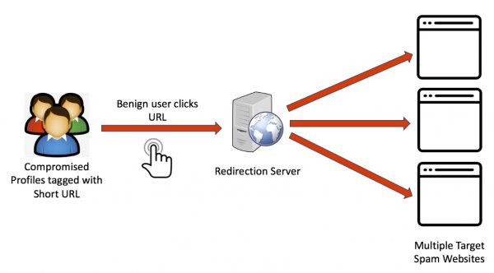
Malicious URL Attack

Slide 5
Motivation
To conduct a survey of famous Social Networking Sites for Spam Detection.
To identify patterns in spam attacks.
To detect spammers on social networking sites.
Analyze the solutions for detecting spammers

Slide 6
Literature review
Justin. Ma, G. M. Voelker suggested a method using the Supervised Machine Learning concepts such as Random Forest Model can classify at 89% without any tuning and feature selection.
Mohammed Al-Janabi, Peter Andras proposed a model that uses the word level and character level Convolutional Neural Networks, as these underlying neural networks are quite handy in dealing with image data for computer vision tasks especially in deriving and learning from the salient features of the images from the raw pixel values.
Doyen Sahoo, Chenghao Liu and Steven C.H.Ho stated that Convolution Neural Networks has shown good performance over the Support Vector Machine algorithm and Logistic Regression algorithm.
Hung Le, Quang Pham proposed a method using Deep Learning Technique, gives the insight about the Dynamic attack detection method in which the JavaScript was embedded to the URL to bypass the detection mechanisms the false positive rate produced by this technique is less than 4.2% in the best case.

Slide 7

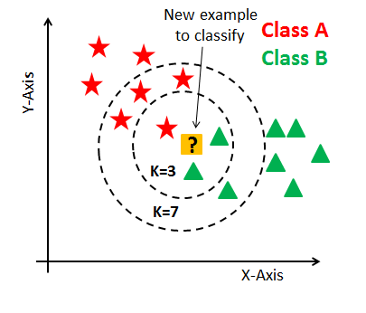

Proposed approach of the work
To develop a Malicious URL detection model using the following Machine Learning Techniques:
Decision Tree
Random Forest
KNeighborsClassifier

Slide 8
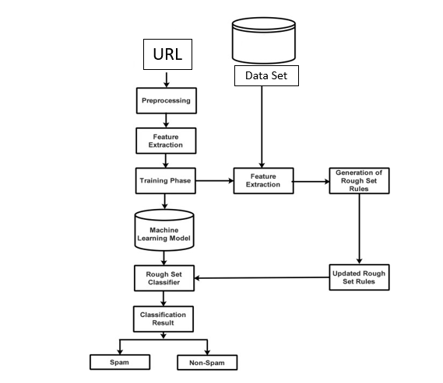
Architecture of the Project

Slide 9
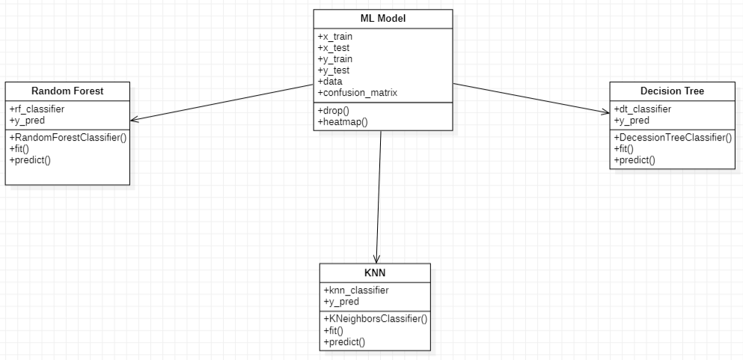
CLASS DIAGRAM

Slide 10
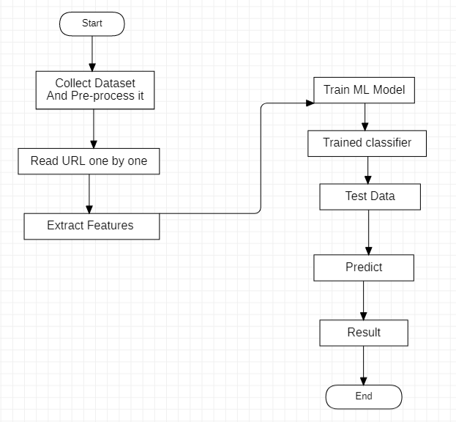
DATAFLOW MODEL

Slide 11
Data Set Description
Name of dataset: malicious_phish
Total number of url’s/items :651192
Split % in Training Dataset: 80
Split % in Testing Dataset :20

Slide 12
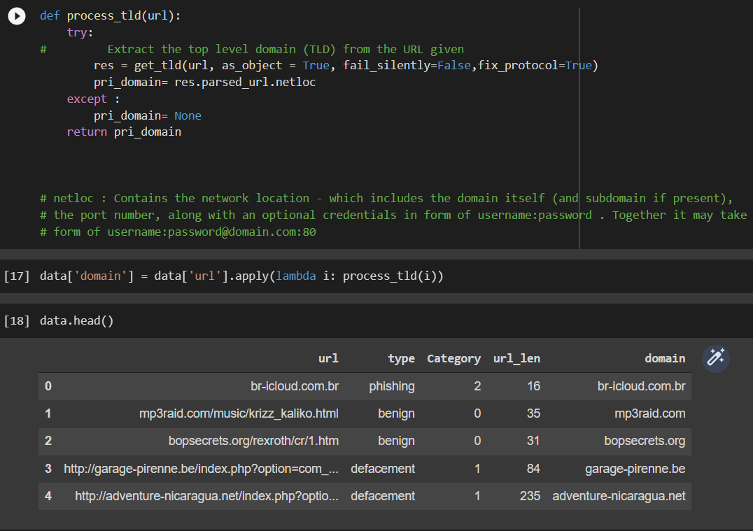
Functions
get_tld(): accurately separates a URL's subdomain, domain, and public suffix

Slide 13
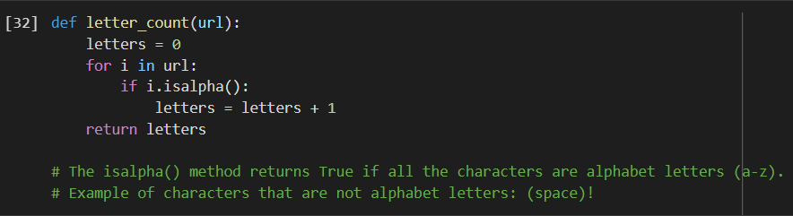
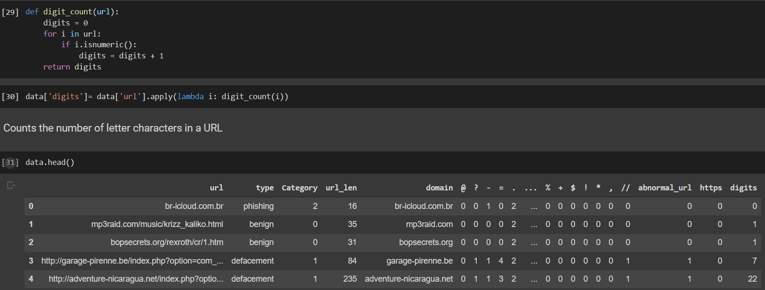
isalpha(): returns true if the character is alphabet
Isnumeric(): returns true if the character is number
13

Slide 14
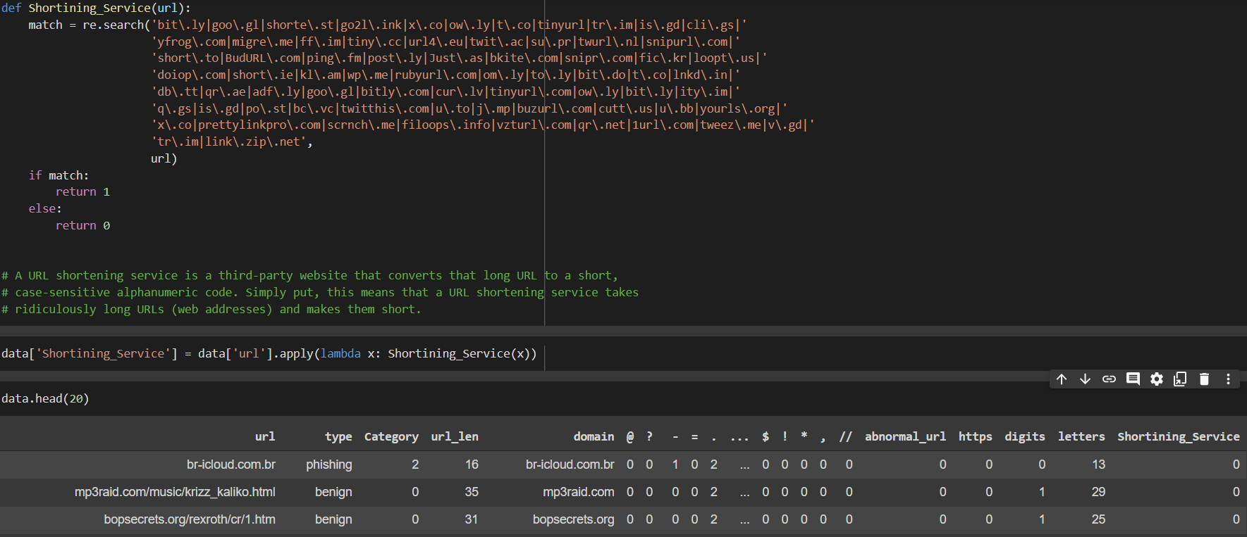
search(string): Checks whether the given string matches the pattern.

Slide 15
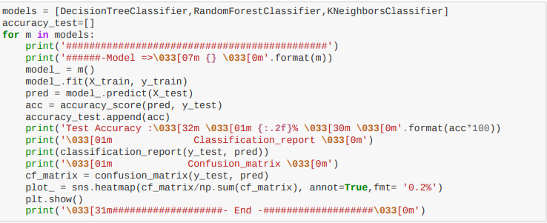
Algorithms
Decision Tree
Random Forest
KNeighborsClassifier

Slide 16
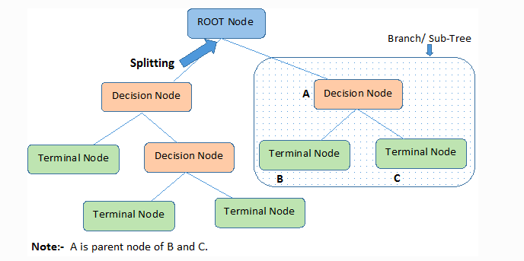
Decision Tree
Decision Tree is a Supervised learning technique that can be used for both classification and Regression problems where internal nodes represent the features of a dataset, branches represent the decision rules, and each leaf node represents the outcome.
The decisions or the test are performed based on features of the given dataset.
It is a graphical representation for getting all the possible solutions to a problem/decision based on given conditions.
It is called a decision tree because, like a tree, it starts with the root node, which expands on further branches and constructs a tree-like structure.
A decision tree simply asks a question and based on the answer (Yes/No), it further split the tree into subtrees.
In order to build a tree, we use the CART algorithm, which stands for Classification and Regression Tree algorithm.

Slide 17
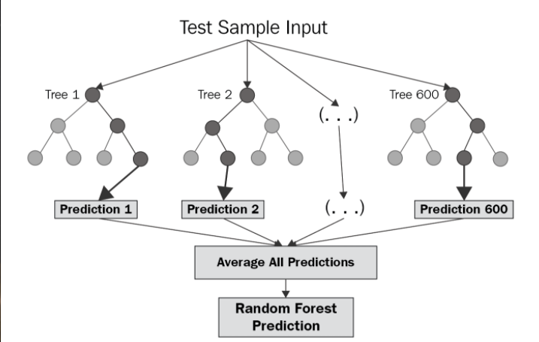
Random forest
Random Forest is a classifier that contains several decision trees on various subsets of the given dataset and takes the average to improve the predictive accuracy of that dataset.
Instead of relying on one decision tree, the random forest takes the prediction from each tree and based on the majority votes of predictions, and it predicts the final output.
The greater number of trees in the forest leads to higher accuracy and prevents the problem of overfitting.
Step-1: Select random K data points from the training set.
Step-2: Build the decision trees associated with the selected data points (Subsets).
Step-3: Choose the number N for decision trees that you want to build.
Step-4: Repeat Step 1 & 2.
Step-5: For new data points, find the predictions of each decision tree, and assign the new data points to the category that wins the majority votes.

Slide 18
KNN Classifier
K-Nearest Neighbour is one of the simplest Machine Learning algorithms based on Supervised Learning technique.
KNN algorithm assumes the similarity between the new case/data and available cases and put the new case into the category that is most similar to the available categories.
KNN algorithm stores all the available data and classifies a new data point based on the similarity. This means when new data appears then it can be easily classified into a well suite category by using KNN algorithm

Slide 19
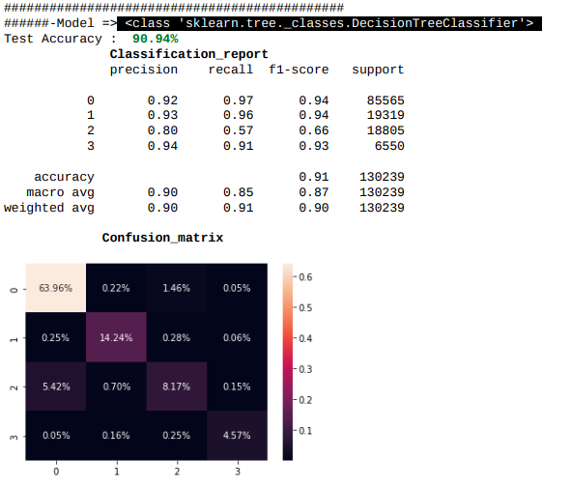
Implementation
Decision Tree

Slide 20
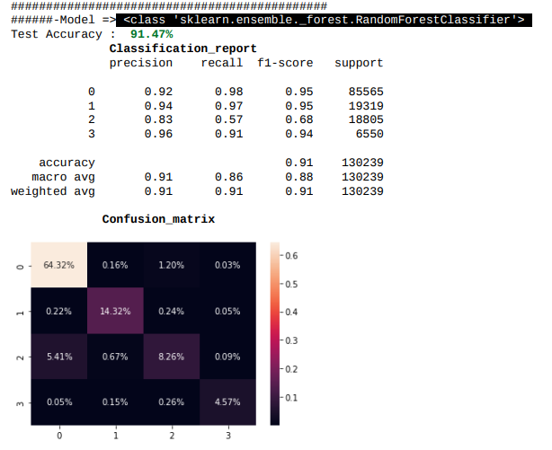
Random Forest

Slide 21
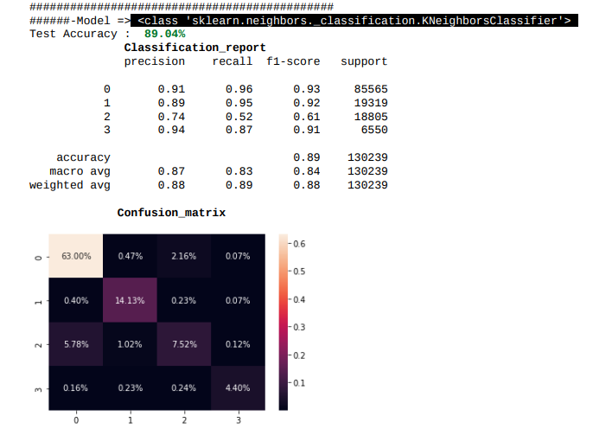
KNeighbour Classifier

Slide 22
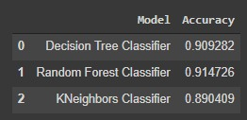
Result Analysis

Slide 23
Conclusion
Malicious URL detection plays a critical role for many cybersecurity applications, and clearly machine learning approaches are a promising direction.
In particular, a systematic formulation of Malicious URL detection from a machine learning perspective, and then detailed the discussions of existing studies for malicious URL detection,particularly in the forms of developing new feature representations, and designing new learning algorithms for resolving the malicious URL detection tasks.
Having categorized most, if not all, the existing contributions for malicious URL detection is studied, and also the requirements are identified and challenges for developing Malicious URL Detection as a service for real-world cybersecurity applications.

Slide 24
Future Scope
Feature Engineering.
To identify vulnerable websites which may become malicious in the future.
To handle the huge number of URLs whose features set will evolve over time.
Data Analysis to further improve the Accuracy.

Slide 25
References
D. Sahoo, C. Liu, S.C.H. Hoi, “Malicious URL Detection using Machine Learning: A Survey”. CoRR, abs/1701.07179, 2017.
Leo Breiman.: Random Forests. Machine Learning 45 (1), pp. 5- 32,(2001).
Rakesh Verma, Avisha Das, “What’s in a URL: Fast Feature Extraction and Malicious URL Detection” proceeding IWSPA ‘17 Proceedings of the 3rd ACM on International Workshop on Security and Privacy Analytics.
Chai-Mei Chen, D.J. Guan, Qun-Kai Su, “Feature set identification for detecting suspicious URLs using Bayesian classification in social networks, Information Sciences, Elsevier, Journal.

Slide 26
THANK YOU

